Slide 1

Well
Come
To my
Presentation
Presented by-
Philip

Slide 2

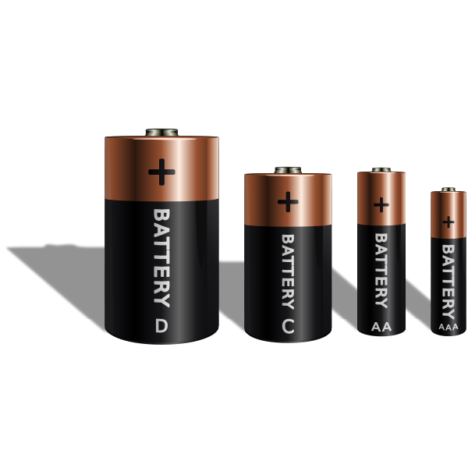
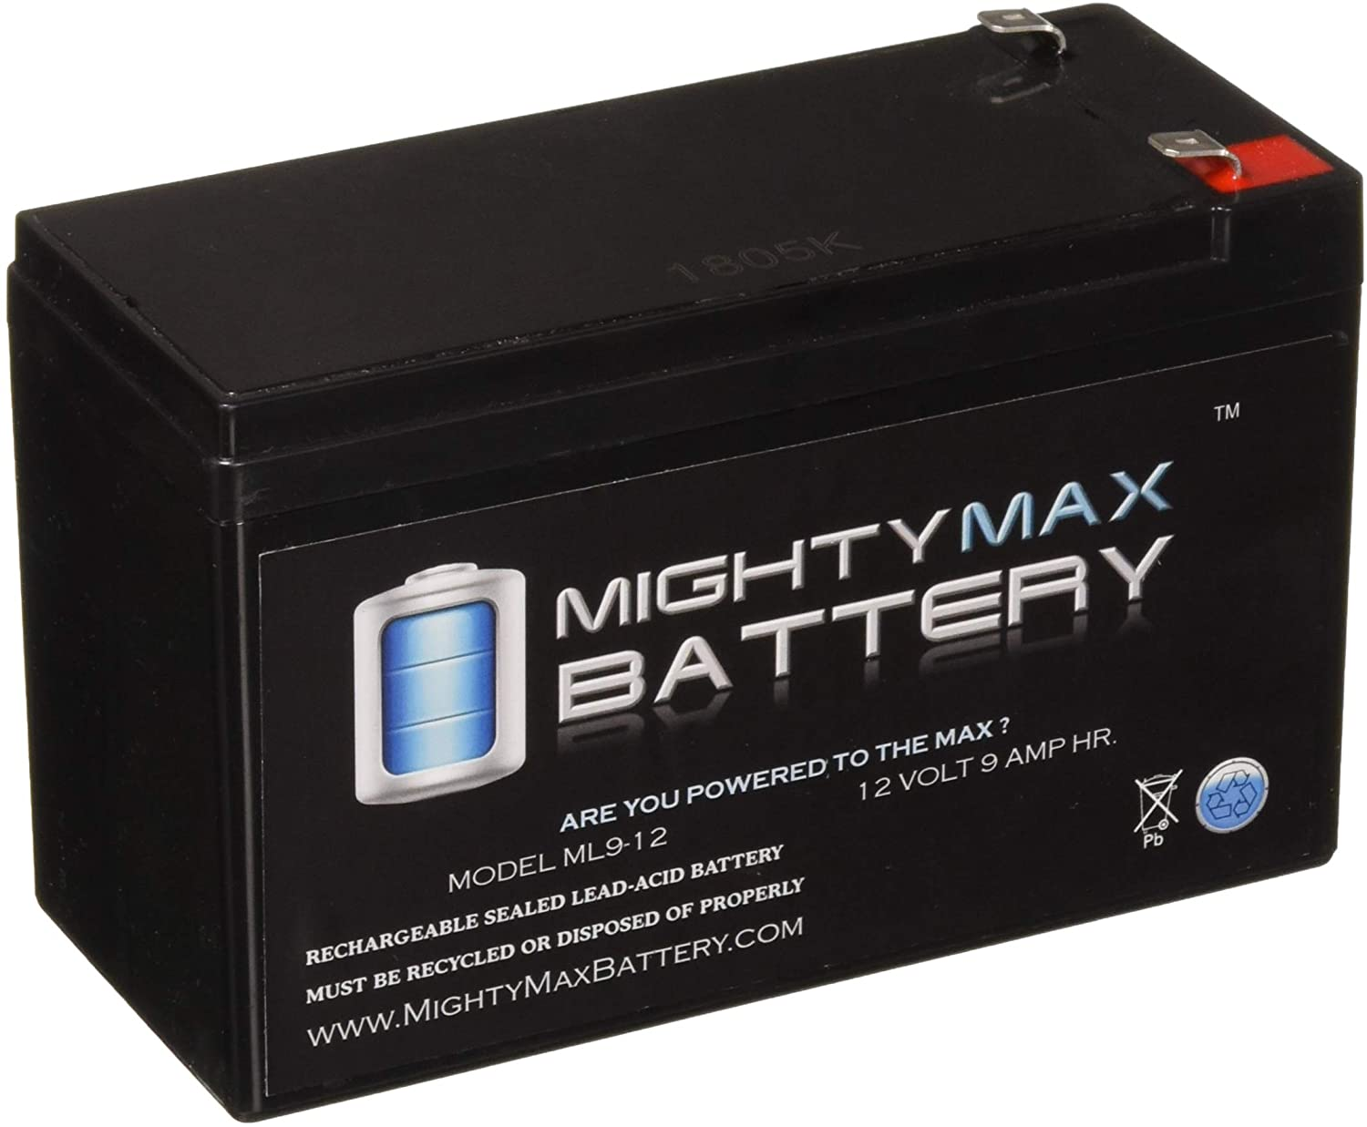
battery

Slide 3

Indent-
What is battery
Types of battery
Advantage of lithium-ion battery
Batteries regarding to data center
Application of battery
Limitation of battery

Slide 4

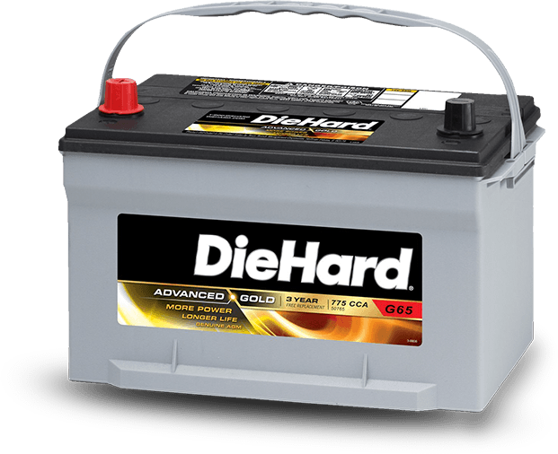
What is battery
A battery can be defined as; is a combination of one or more electrochemical cells that are capable of converting stored chemical energy into electrical energy.

Slide 5
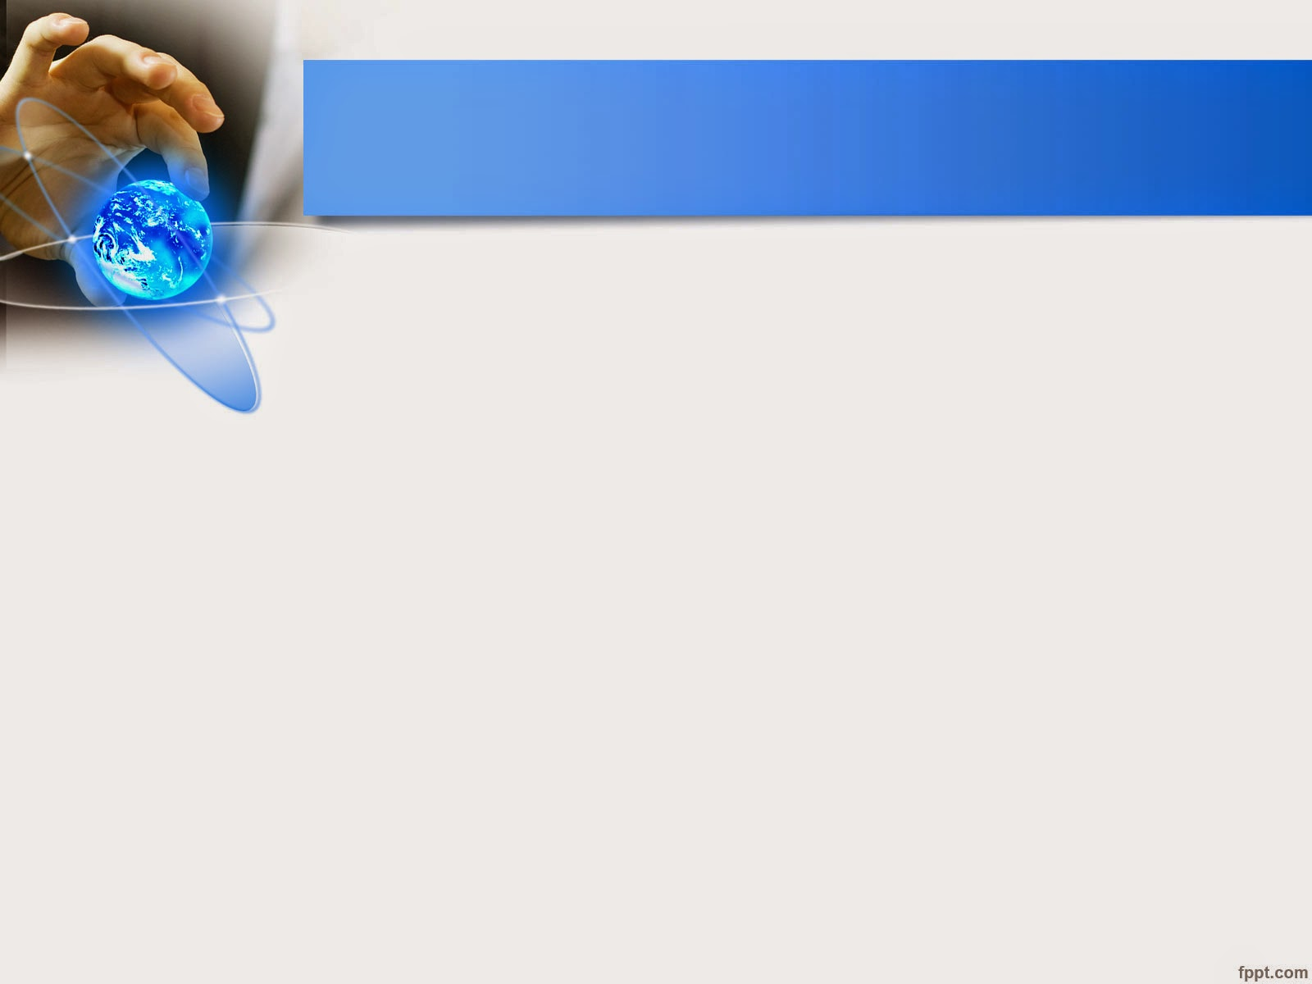
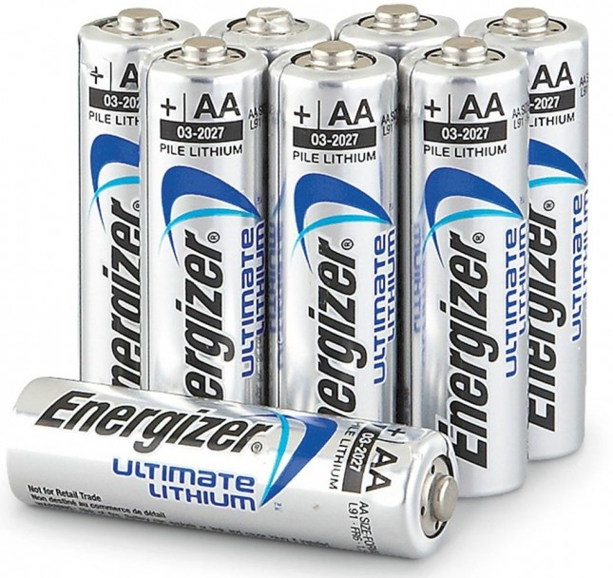
Types of battery
Primary battery and
Secondary battery
Primary battery-
As name indicates these batteries are meant for single usage. Once these batteries are used they cannot be recharged as the devices are not easily reversible and active materials may not return to their original forms.
Examples- wall clock , television remote

Slide 6

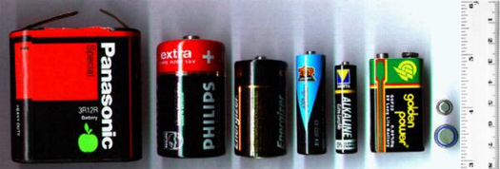
Secondary battery-
Secondary batteries are those batteries which can be recharged by passing electric current through them and hence can be used over again e.g., lead storage battery.
Examples- mobile phone , mp3 players etc.
Types of secondary battery-
SMF,
Lead Acid,
Li and
Nicd

Slide 7

Advantage of lithium - ion battery
Light weight compared to others batteries of similar size
Available in different shape including flat shape
High open circuit voltage that increases the power transfer at low current
Lack of memory effect
Eco-friendly battery without any free lithium metal

Slide 8

Battery regarding to data center
While standard data centers will most often use Lead acid battery cells , major corporations like these have already made the move to the more modern lithium-ion batteries, like the one you will find in your smartphone.

Slide 9

Application of battery-
House.
Health Instruments.
Medical.
Logistics and construction.
Firefighting and Emergency.
Military.

Slide 10

Limitation of battery-
Cannot be stored in a discharged condition.
Low energy density.
Allows only a limited number of full discharge cycles.
Environmentally unfriendly.
Thermal runaway can occur with improper charging.

Slide 11

Thank
You

